Slide 1
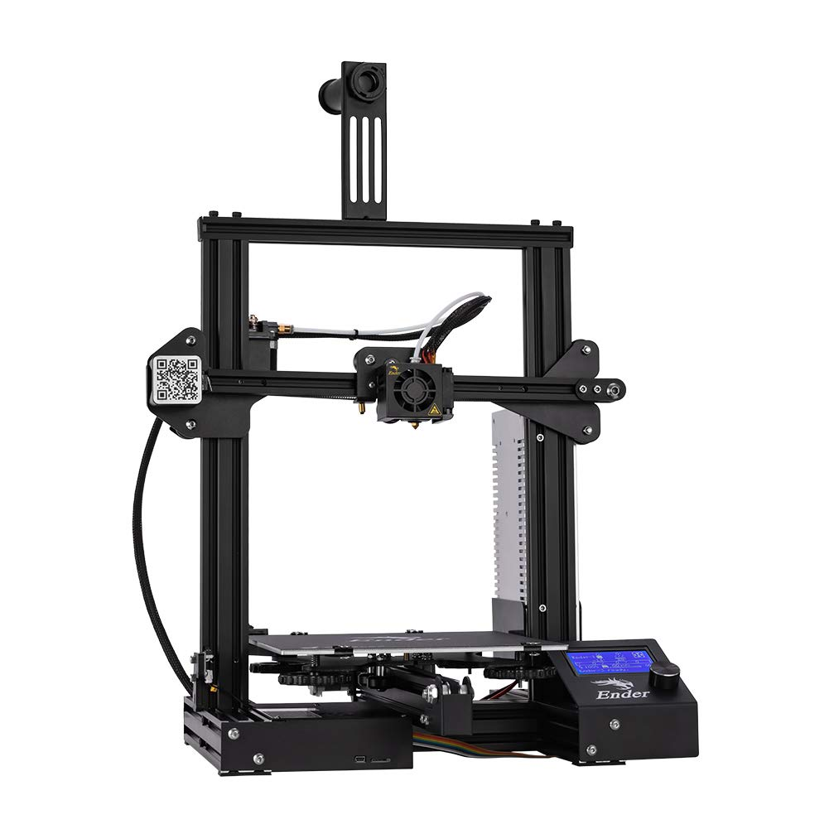

3D Printer and Application Interface Cody Hutchison
Steven Liu
Abigail Morar

Slide 2
Executive Summary
Problem Statement
Current 3D printers require the user to manually upload a G-code file by an external storage device and initiate the printing process via controls on the printer
Solution
The new 3D printer and Application will allow the uploading, controlling, and initiation of printing from anywhere with internet access
Quicker Z-axis motion
Print time within 10% of a regular Ender 3 Printer

Slide 3
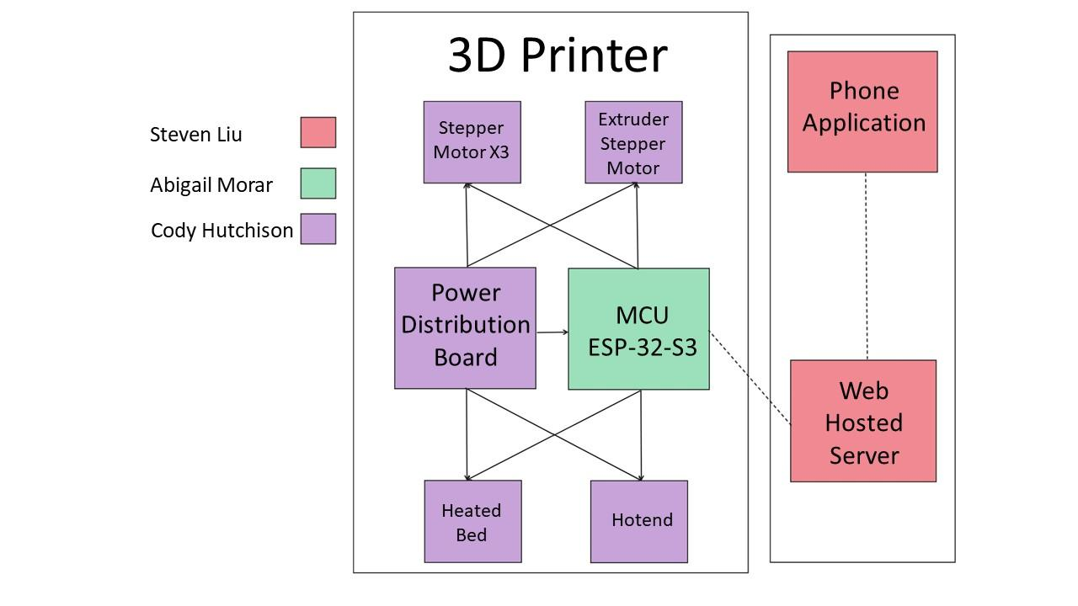
System Overview

Slide 4
Task Partition
Abigail: Program ESP32-S3
Cody: Design power distribution board, stepper motor, hotend, and heated bed controllers
Steven: Design and program the application and web hosted server

Slide 5
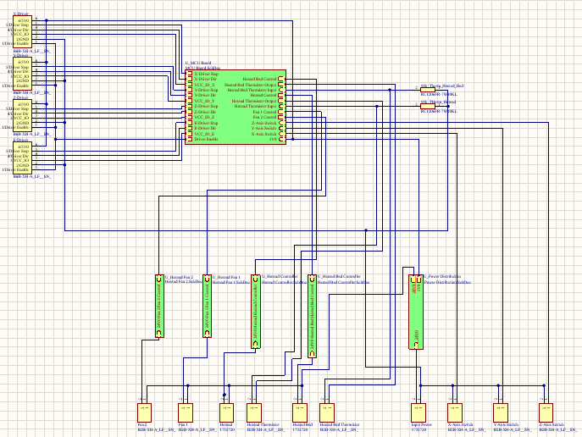
Main Controller PCB
Heated Bed Power Output
I = 8.5 A
V = 23.921 V
P = 201.28 W
Hotend Power Output
I = 1.7 A
V = 23.921 V
P = 40.6657 W
Fan 1 Power Output
I = 68 mA
V = 24.028 V
P = 1.6339 W
Fan 2 Power Output
I = 47 mA
V = 24.028 V
P = 1.1293 W
Driver Voltages
X-Axis Voltage
5.021V
Y-Axis Voltage
5.021V
Z-Axis Voltage
5.021V
Extruder Voltage
5.021V

Slide 6
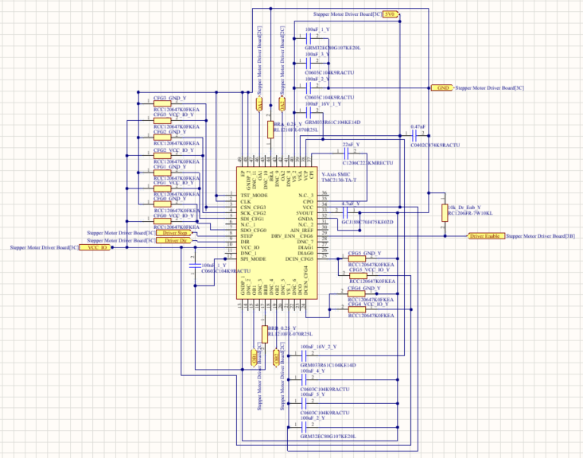
Stepper Motor Driver PCB
Currently the stepper motors aren’t working due to design issues
Rework is in progress to correct the design issues such as multiple missed grounds, a power input, and incorrect pattern for connector,

Slide 7
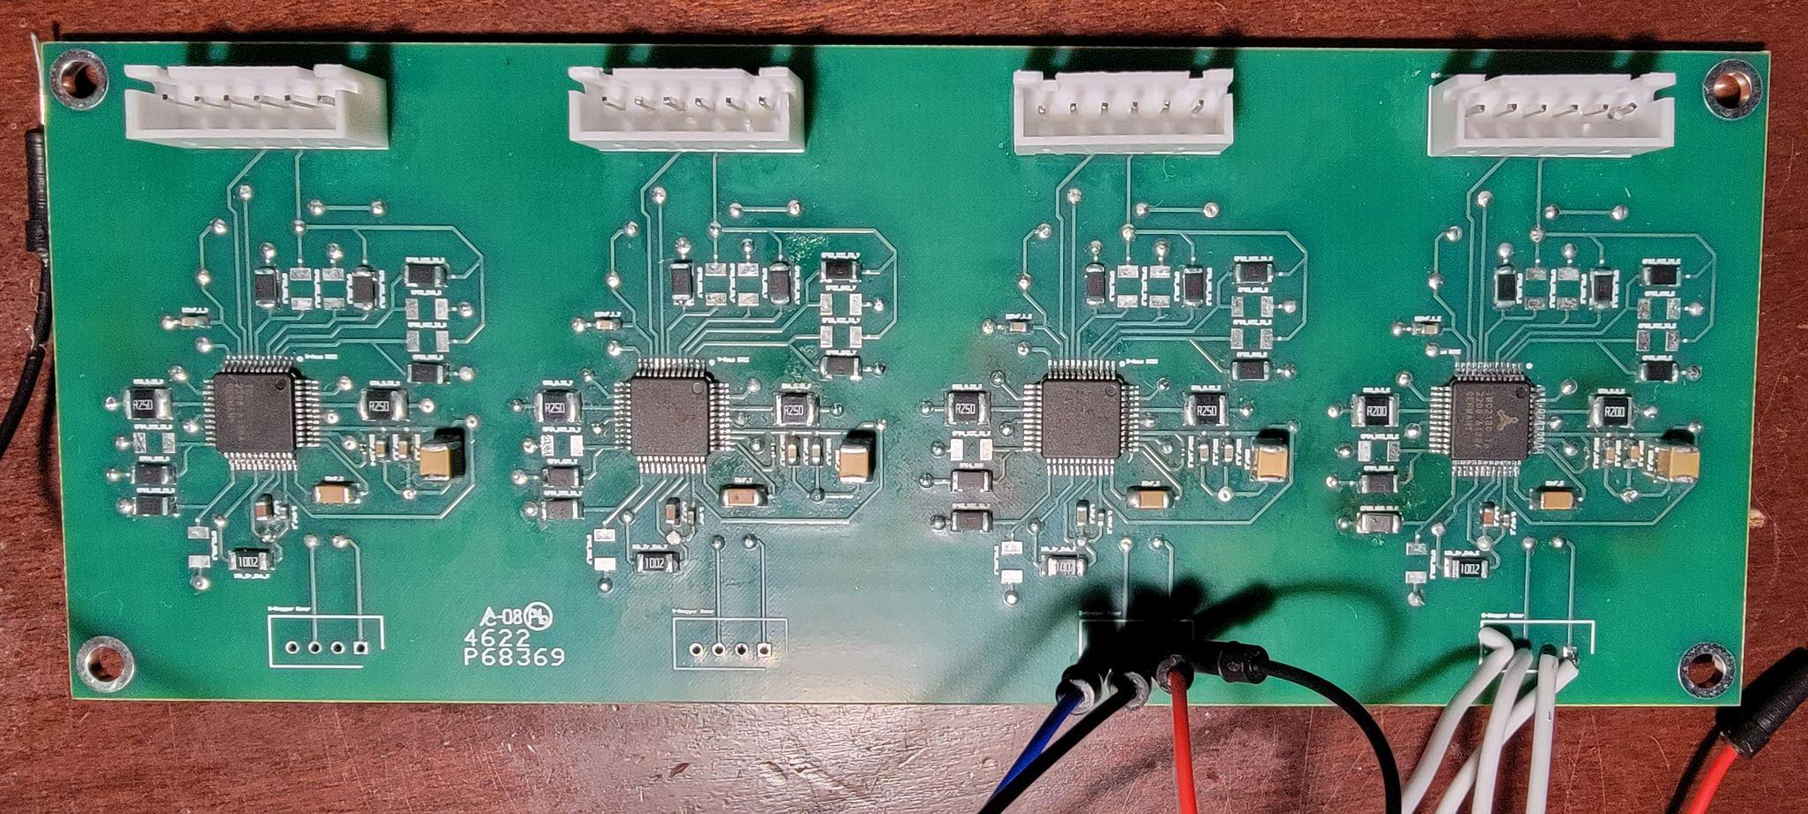
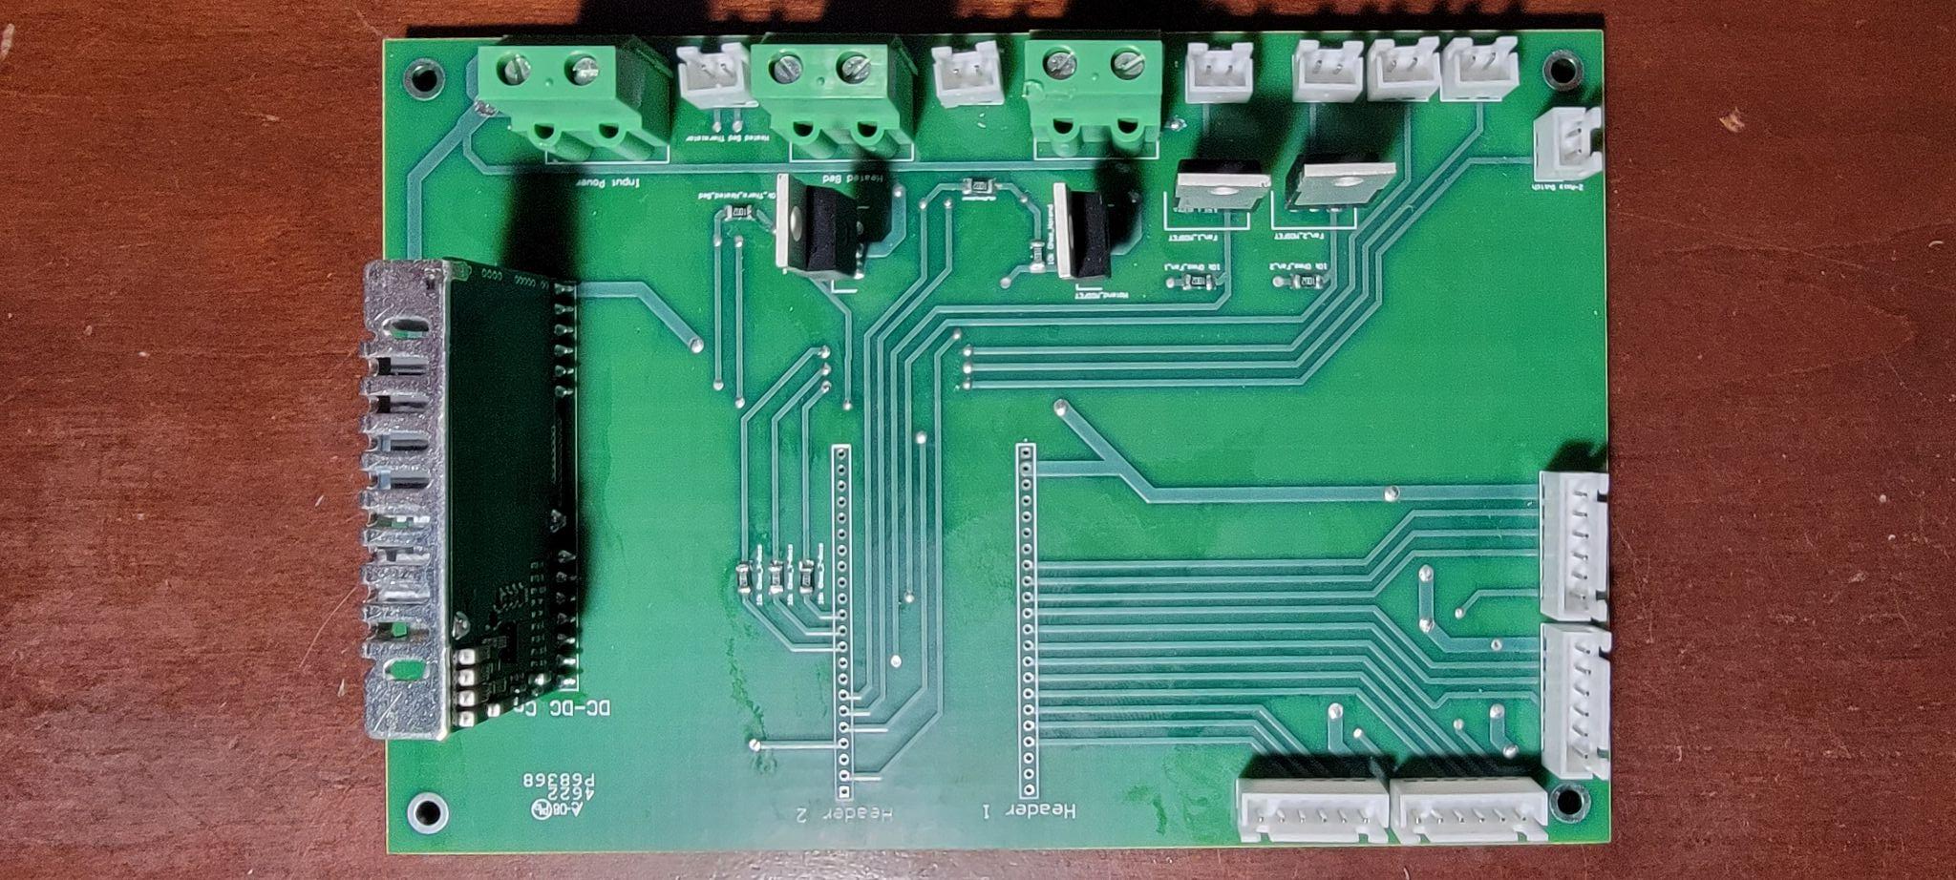
Current PCB’s
Stepper Motor Drivers
Main Controller

Slide 8
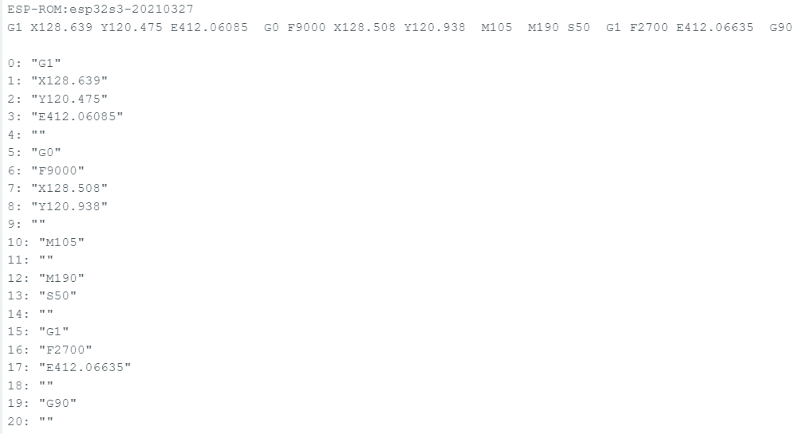
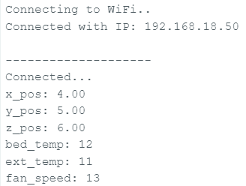
MCU Coding/Results

Slide 9
MCU Challenges…
…and Solutions/Going Forward
Understanding Gcode
Learning the Espressif IDE
Programming stepper motor controls
More research
Integrate code in ESP IDF
microstep to mm conversion

Slide 10
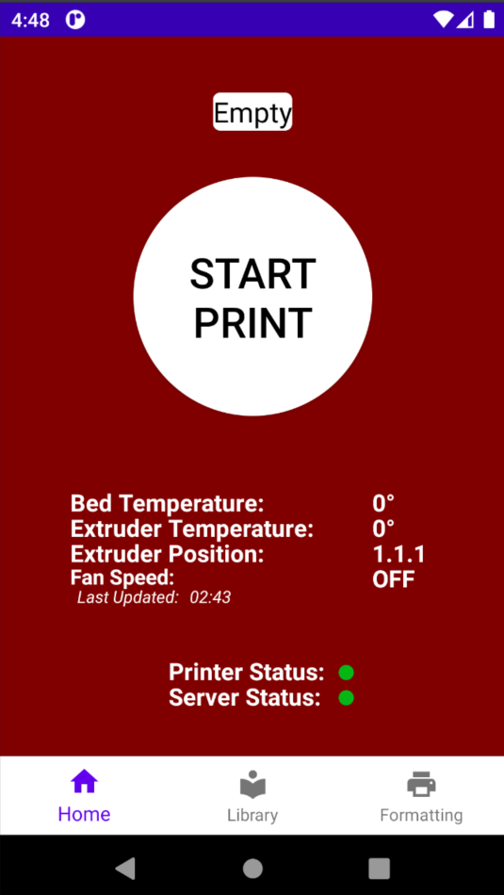
Phone Application and Server
Progress
Application has full printer controls
Interactive library view
Application file chooser
Application and server connection
Working Firebase storage
Working Firebase realtime database
Working on physical device
Ongoing Progress and Problems
Bug: navigation bar does not change to home tab when a file is selected but viewing does
Bug: uploading url of print file in storage to database works roughly 95% of the time

Slide 11
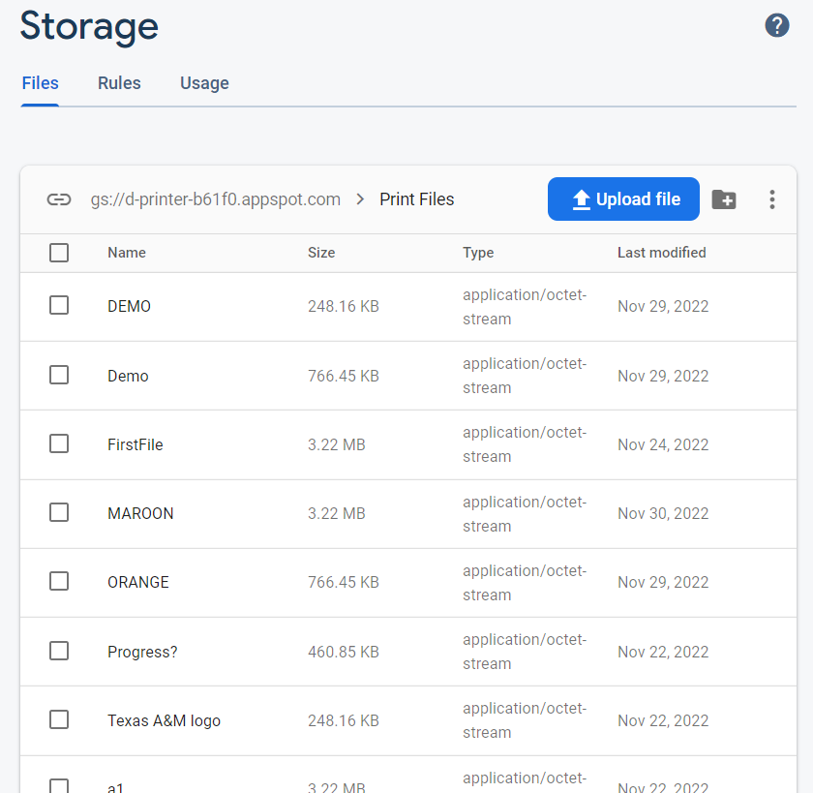
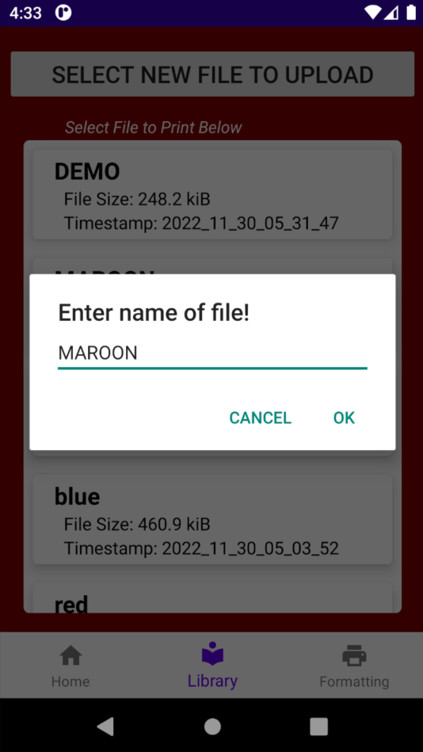
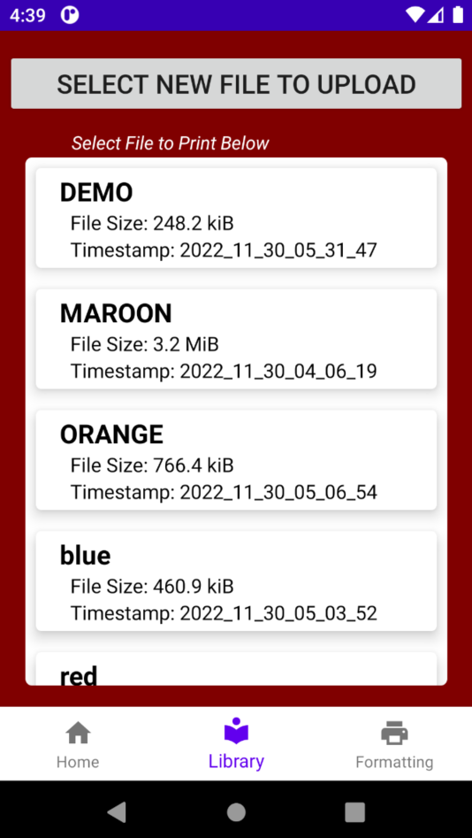
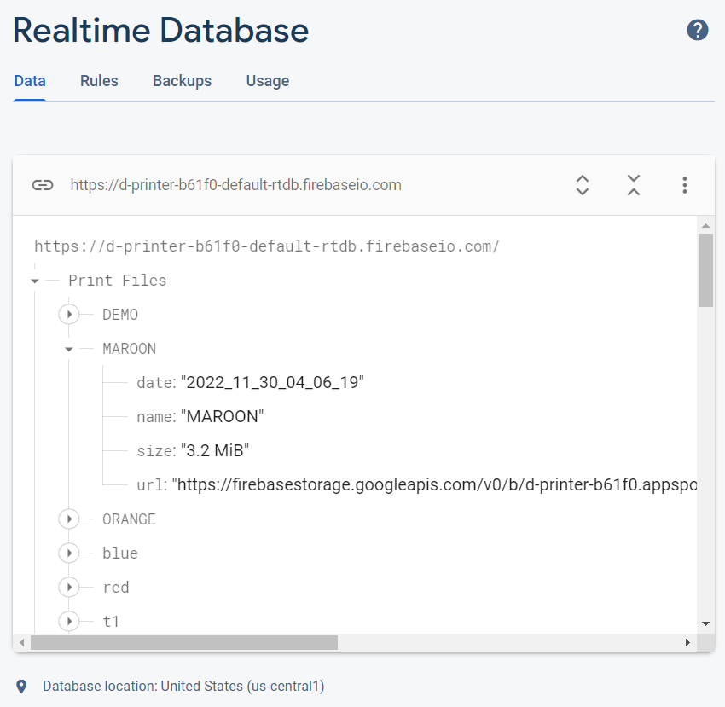
Uploading and Displaying File

Slide 12
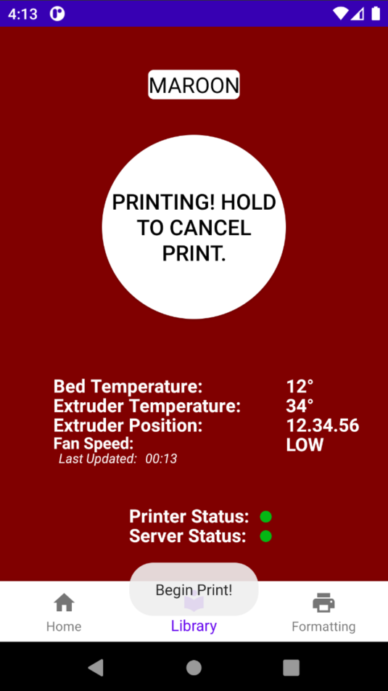
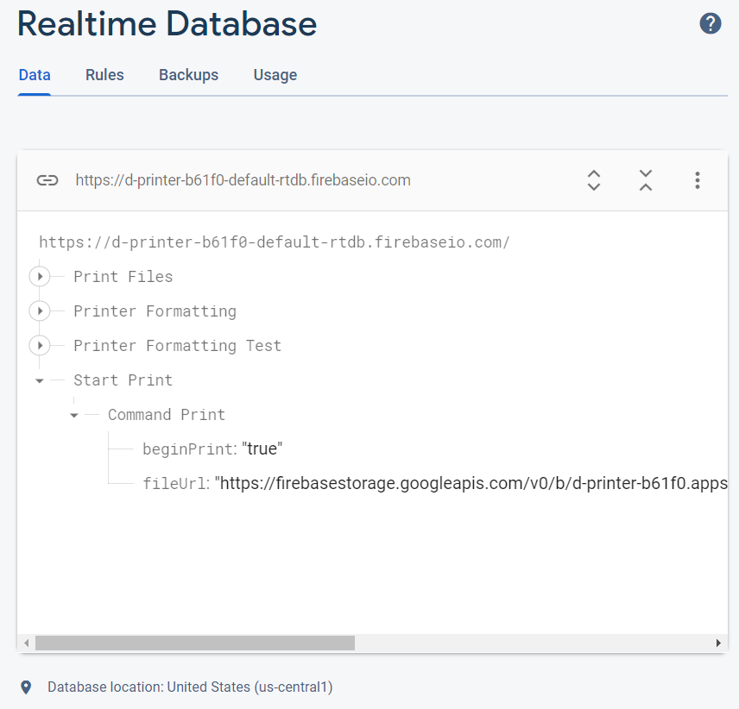
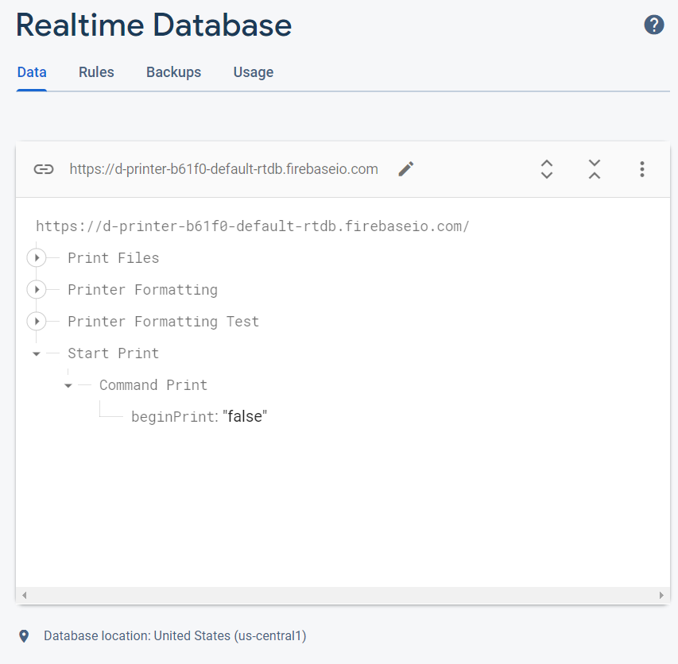
Start and Stopping Print

Slide 13
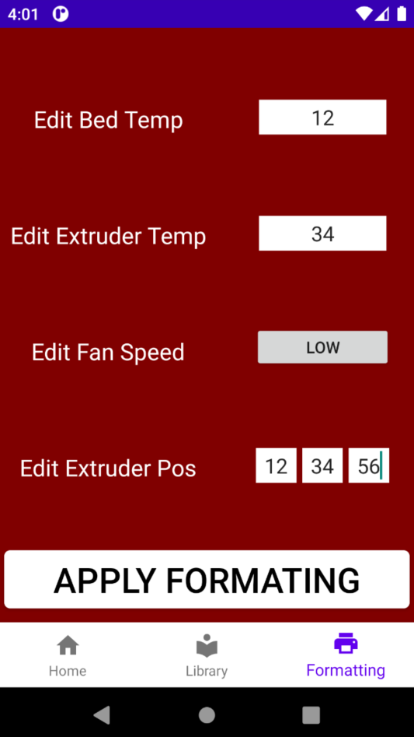
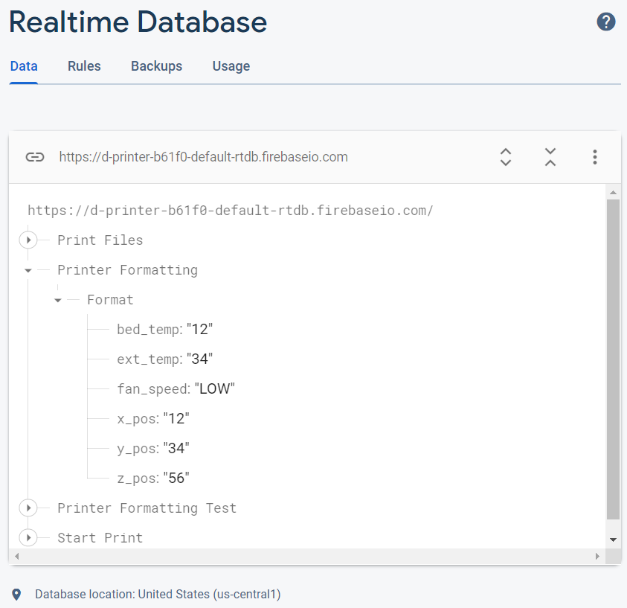
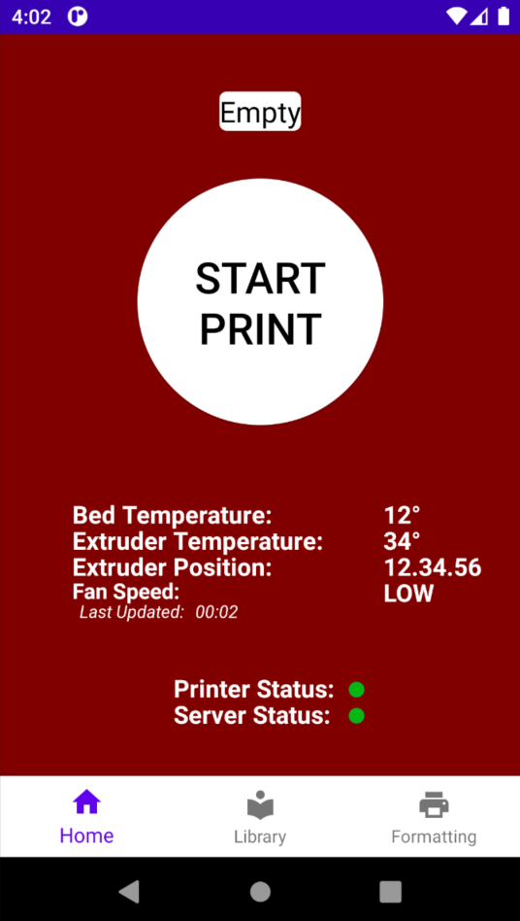
Change Printer Formatting

Slide 14
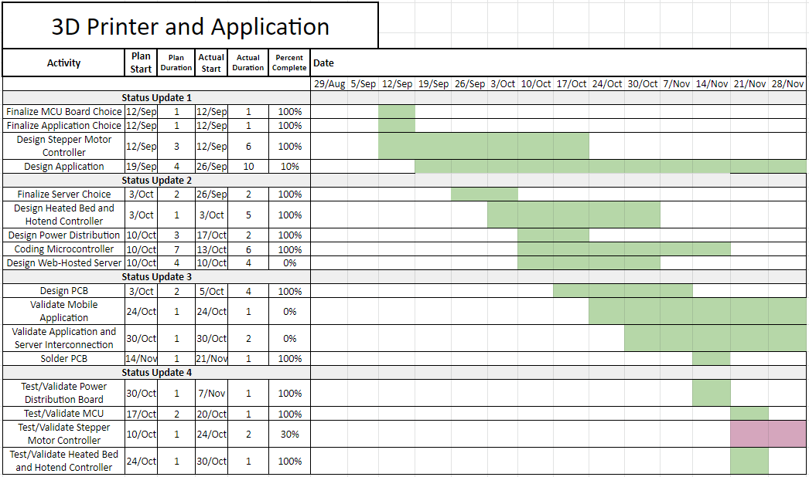
Execution Plan

Slide 15
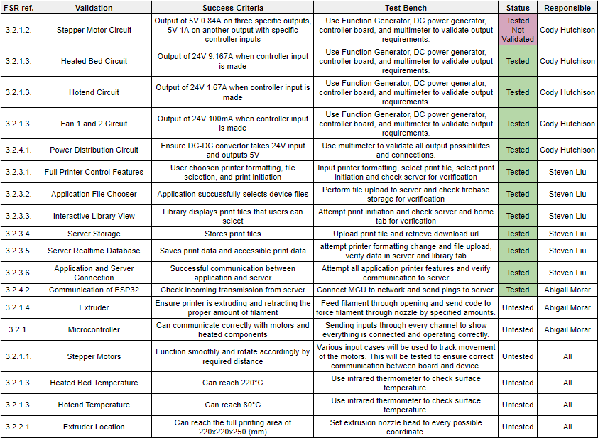
Validation Plan

